Slide 1




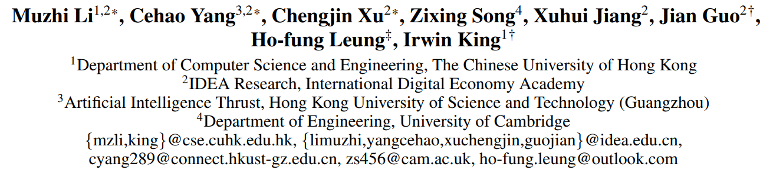



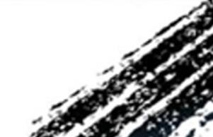

ATAI
Advanced Techniqueof Artificial Intelligence
ATAI
ChongqingUniversity _{AdvancedTechniqueof}
of Technology Artificial Intelligence
Chongqing University of
Technology
Chongqing University ^{ATAI}
_{of Technology} Advanced Techniqueof
Artificial Intelligence
Chongqing University of Technology
Chongqing University of Technology
  Context-aware Inductive Knowledge Graph Completion with Latent Type Constraints and Subgraph Reasoning
Code: https://github.com/IDEA-FinAI/CATS
2025.7.16•ChongQing
—— AAAI 2025
Reported by Shunan Yin
1
Notes:
具有潜在类型约束和子图推理的上下文感知归纳知识图谱补全

Slide 2

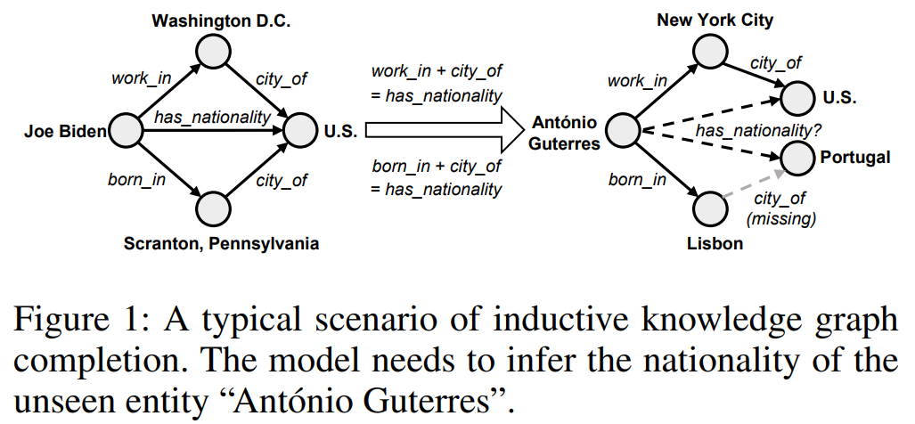
ATAI
AdvancedTechniqueof
Artificial Intelligence
ATAI
ChongqingUniversity _{AdvancedTechniqueof}
of Technology Artificial Intelligence
ChongqingUniversity of Technology
Motivation
1)Existing methods cannot fully utilize these contexts. (Entity types, reasoning paths, and neighboring facts)
2)LLM-based KGC methods can only re-rank candidate answers provided by previous KGC approaches. Consequently, they are inevitably constrained by the limitations of preceding models.
Notes:
训练图：包含三元组 (Joe Biden,born in,Scranton)、(Scranton,city of,U.S.)、(Joe Biden,has nationality,U.S.)。
测试图：查询三元组为 (Antoˊnio Guterres,has nationality,?)，测试图中存在辅助三元组 (Antoˊnio Guterres,born in,Lisbon)、(Lisbon,city of,Portugal)
Antoˊnio Guterres（未见实体，测试图独有），Portugal（需预测的尾实体）。
关系序列 r0​=born in，r1​=city of（均在训练图中出现过）。
中间实体 e1​=Lisbon（测试图独有，未见实体）。

Slide 3

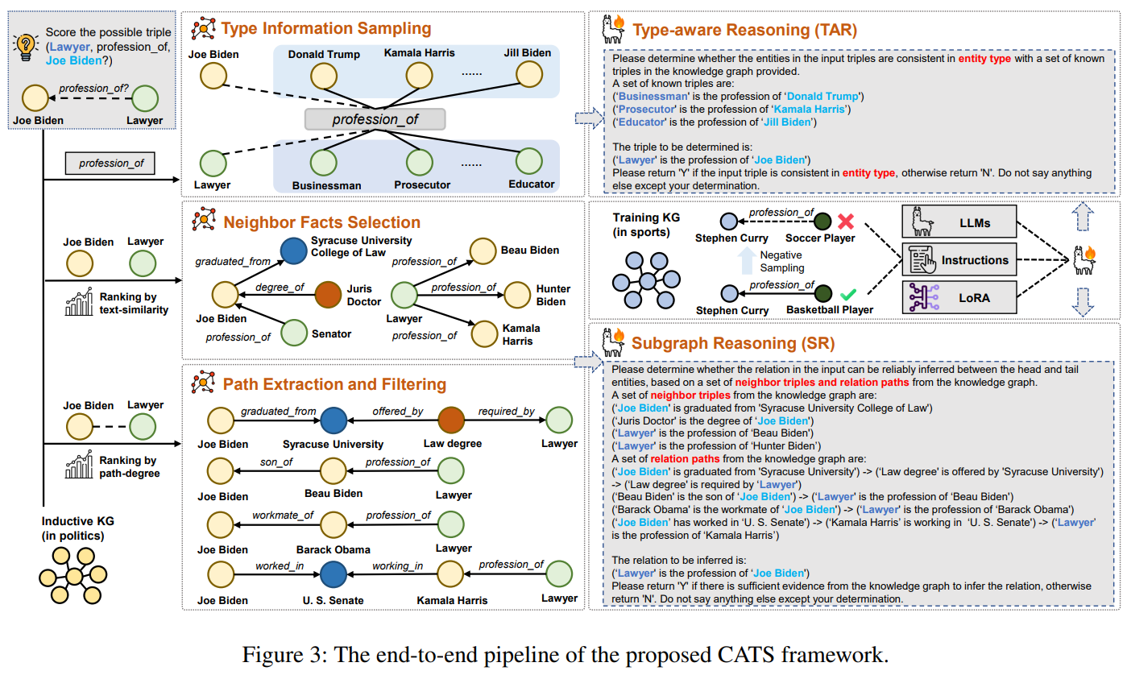
ChongqingUniversity of Technology
ATAI
AdvancedTechniqueof
Artificial Intelligence
ATAI
ChongqingUniversity _{AdvancedTechniqueof}
of Technology Artificial Intelligence
Overview

Slide 4

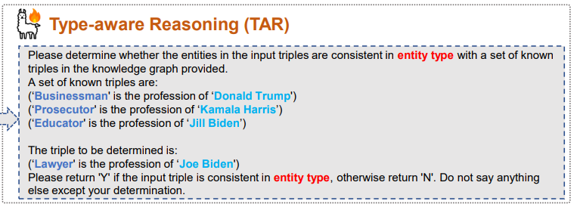
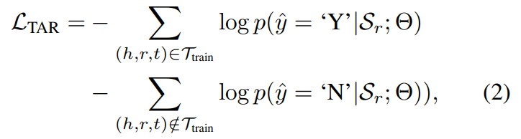
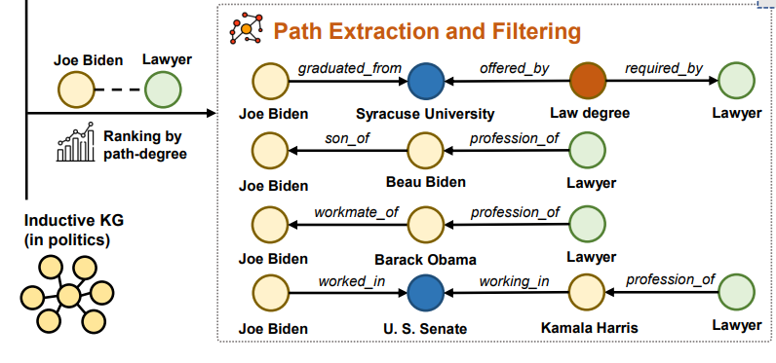
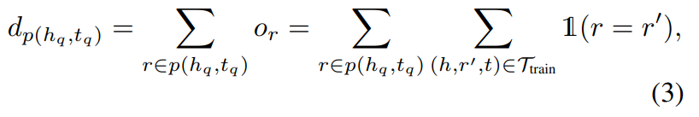
ChongqingUniversity of Technology
Method
ATAI
AdvancedTechniqueof
Artificial Intelligence
ATAI
ChongqingUniversity _{AdvancedTechniqueof}
of Technology Artificial Intelligence

Slide 5
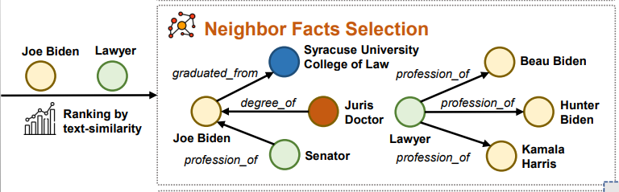
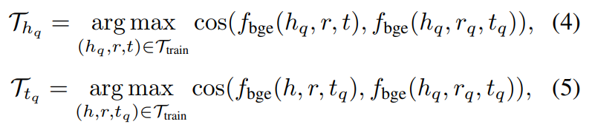
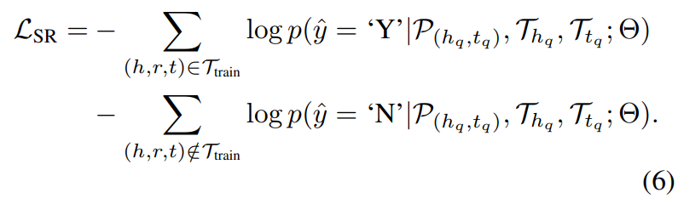
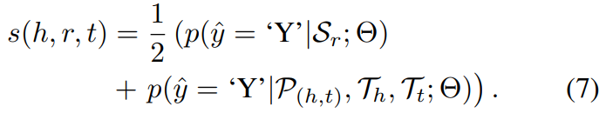
ChongqingUniversity of Technology
Method
ATAI
AdvancedTechniqueof
Artificial Intelligence
ATAI
ChongqingUniversity _{AdvancedTechniqueof}
of Technology Artificial Intelligence

Slide 6

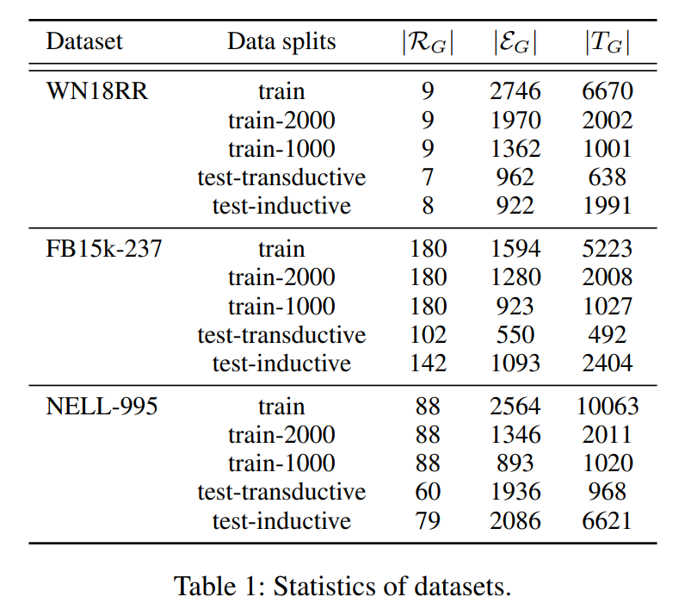
ATAI
AdvancedTechniqueof
Artificial Intelligence
ATAI
ChongqingUniversity _{AdvancedTechniqueof}
of Technology Artificial Intelligence
ChongqingUniversity of Technology
Experiments

Slide 7
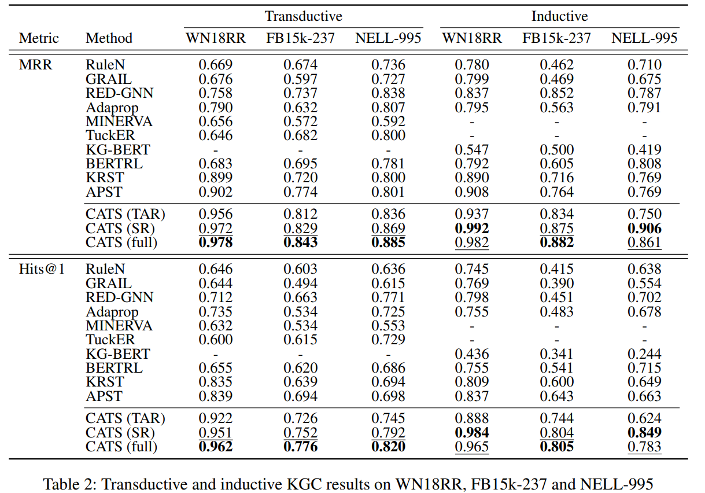
Experiments
ATAI
AdvancedTechniqueof
Artificial Intelligence
ATAI
ChongqingUniversity _{AdvancedTechniqueof}
of Technology Artificial Intelligence
ChongqingUniversity of Technology

Slide 8
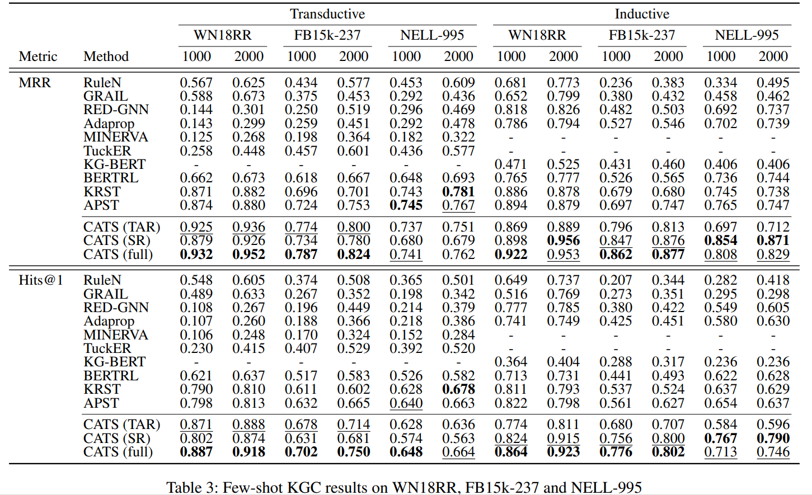
Experiments
ATAI
AdvancedTechniqueof
Artificial Intelligence
ATAI
ChongqingUniversity _{AdvancedTechniqueof}
of Technology Artificial Intelligence
ChongqingUniversity of Technology

Slide 9
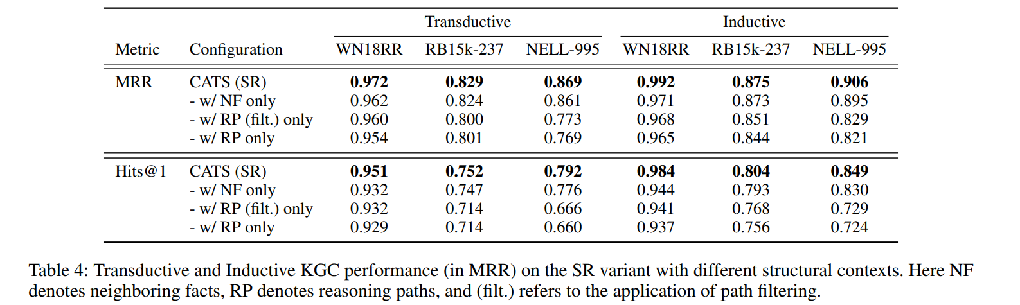
ATAI
AdvancedTechniqueof
Artificial Intelligence
ATAI
ChongqingUniversity _{AdvancedTechniqueof}
of Technology Artificial Intelligence
ChongqingUniversity of Technology
Experiments

Slide 10
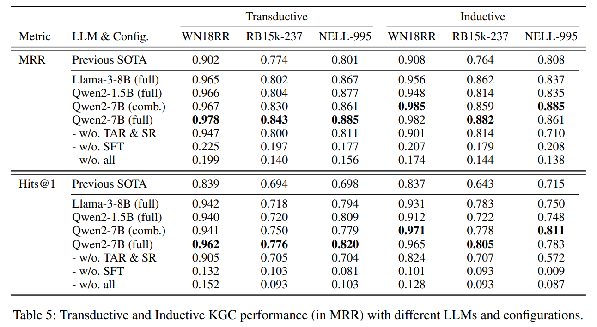
ATAI
AdvancedTechniqueof
Artificial Intelligence
ATAI
ChongqingUniversity _{AdvancedTechniqueof}
of Technology Artificial Intelligence
ChongqingUniversity of Technology
Experiments

Slide 11


ChongqingUniversity of Technology
ATAI
AdvancedTechniqueof
Artificial Intelligence
ATAI
ChongqingUniversity _{AdvancedTechniqueof}
of Technology Artificial Intelligence
Thanks!

